Slide 1

Zepto Grocery Analysis
Operational efficiency & pricing strategy insights

Slide 2
ANALYSIS OVERVIEW
Data Preparation & Cleaning
Null Value Check
Data Integrity
Duplicate Analysis
Validated critical columns for missing data
Removed invalid records, converted Paise to Rupees
Identified SKU variations for product depth

Slide 3

PRICING STRATEGY
Best Value Products
Loss Leaders Drive Traffic
Top 10 products with highest discounts (50-51%)
Dukes Waffy varieties: 51% off
RRO Mozzarella: 50% off
Ceres Foods instant meals: 50% off

Slide 4
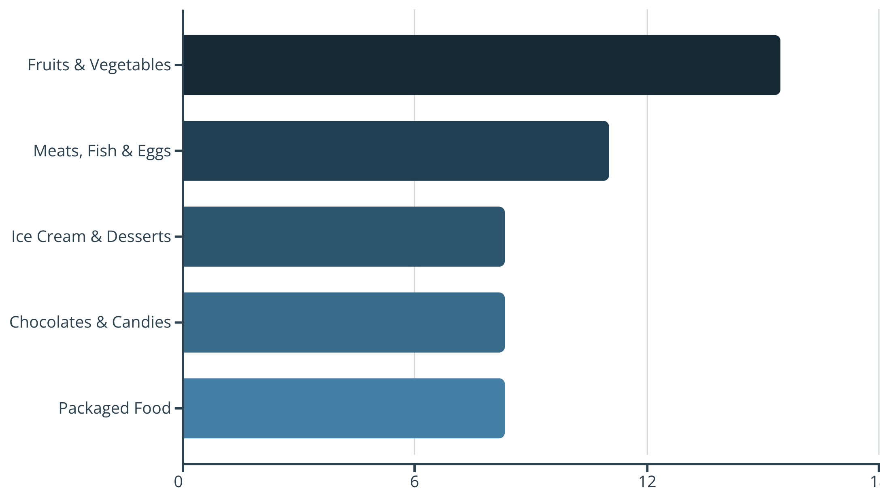
Category Discount Trends
Discount Strategy Insights
Fresh categories rely heavily on discounts to drive volume
Packaged goods maintain stable pricing with lower discounts

Slide 5


Premium Low-Discount Products
39 products with MRP > ₹500 and discount < 10%
Dhara Mustard Oil
Saffola Gold
Fortune Rice Bran Oil
₹1,250 MRP • 8% discount
₹1,240 MRP • 0% discount
₹1,050 MRP • 1% discount
Higher margin retention opportunities with price-insensitive customers

Slide 6

REVENUE ANALYSIS
Revenue Potential by Category
Top Revenue Categories
₹123K
₹64K
₹55K
Home & Cleaning
Health & Hygiene
Beverages
Consistent demand driver
Highest warehouse value
Strong inventory position

Slide 7
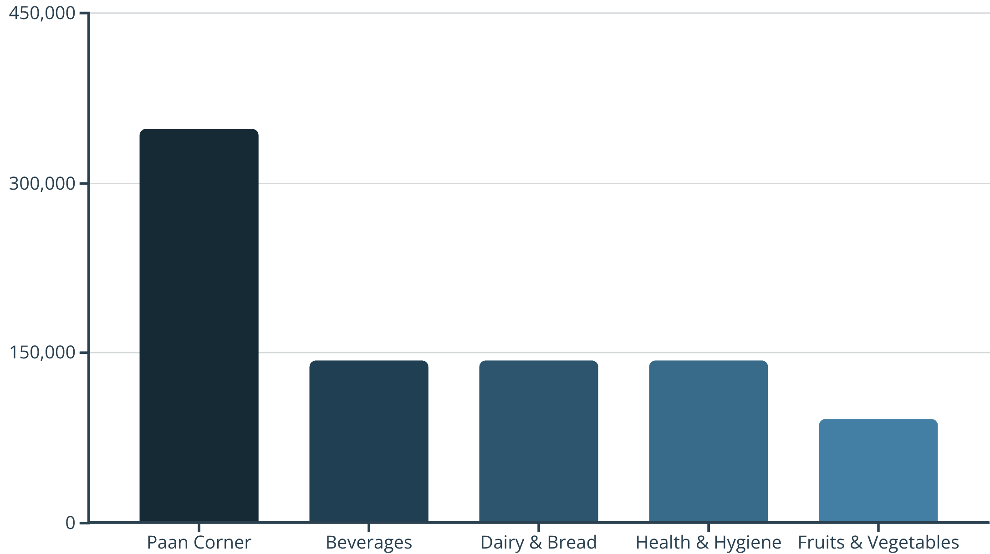
Inventory Weight Analysis
Logistics Planning Insights
Heavier categories require specialized supply chain handling
Weight distribution impacts transportation costs and delivery efficiency

Slide 8


CRITICAL ALERT
High-Value Stock-Outs
Patanjali Cow's Ghee
MamyPoko Diapers XL
Aashirvaad Multigrain Atta
Everest Kashmiri Chilli
₹565 MRP • Currently unavailable
₹399 MRP • Out of stock
₹315 MRP • Needs restocking
₹310 MRP • Lost revenue opportunity
Priority restocking required for premium items representing direct revenue loss

Slide 9
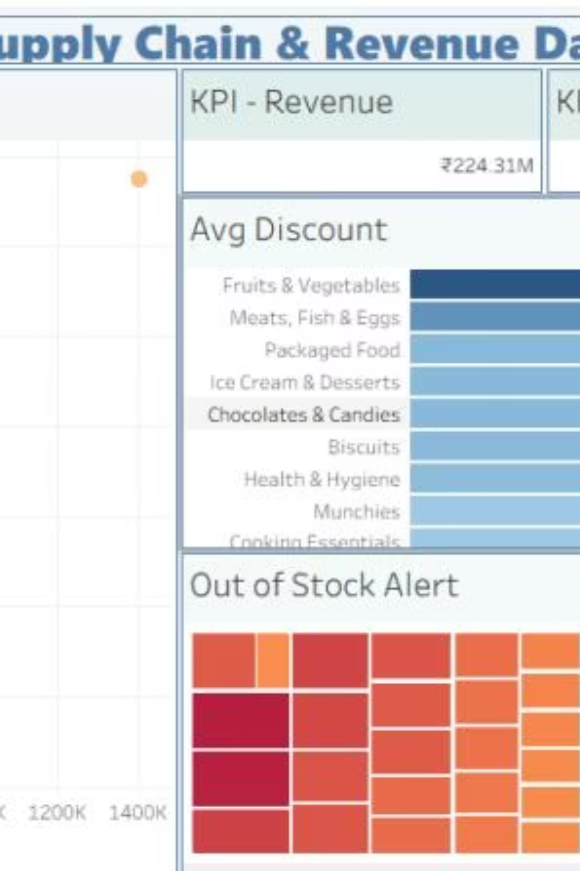
Interactive Dashboard
₹224.31M Revenue
Total inventory potential
Weight-Revenue Matrix
Logistics efficiency visualization
Real-Time Alerts
Stock health monitoring

Slide 10



KEY RECOMMENDATIONS
Strategic Action Items
Optimize High-Volume Logistics
Reduce shipping costs for ₹34M+ category with 1,400K+ weight
Test Discount Strategy
A/B test lower discounts on Fruits & Vegetables to improve margins
Restock Premium Items
Immediate action on top 5 high-MRP out-of-stock SKUs

